Slide 1

Credit Card Customer Churn
Exploratory Data Analysis

Slide 2
Why is the analysis of credit card customer churn important?
Customer acquisition is more costly than customer retention
Longer retention results in greater revenue and cost savings
Allows opportunities for cross-selling

Slide 3
Problem Questions
What might be the cause or trigger for customer churn?
What could we do to reduce attrition?
What could we do to improve our overall revenue from credit card customers?

Slide 4
Data
7,000 customers (3000 dropped due to missing fields)
16% churn
Captures details over 12 months
Assume attrition is at the end of the 12 months (snapshot where customer just exited)

Slide 5
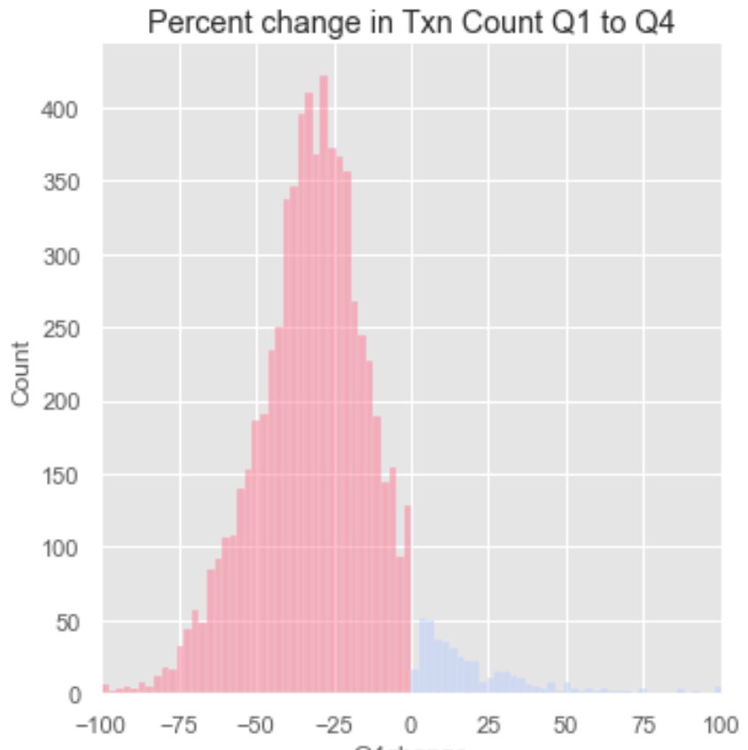
Significant proportion of customers utilize their card less in Q4 than in Q1
Disproportionately high number of customers show a decrease in transactions in Q4 as compared to Q1
This does not make sense as Q4 is usually the holiday period
Likely customers are utilizing competitor’s credit cards
negative

Slide 6
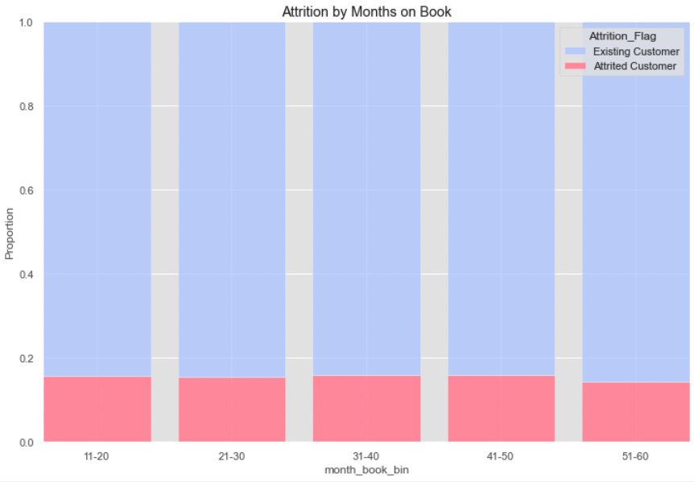
On-book length does not increase attrition rate
No significant change

Slide 7
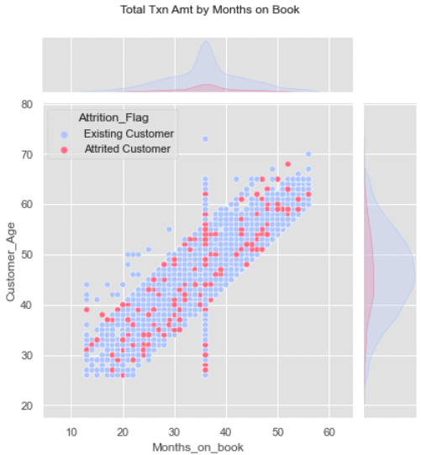
Older customers tend to hold on to their credit cards longer
Majority of customers in the 40-50 yr range

Slide 8
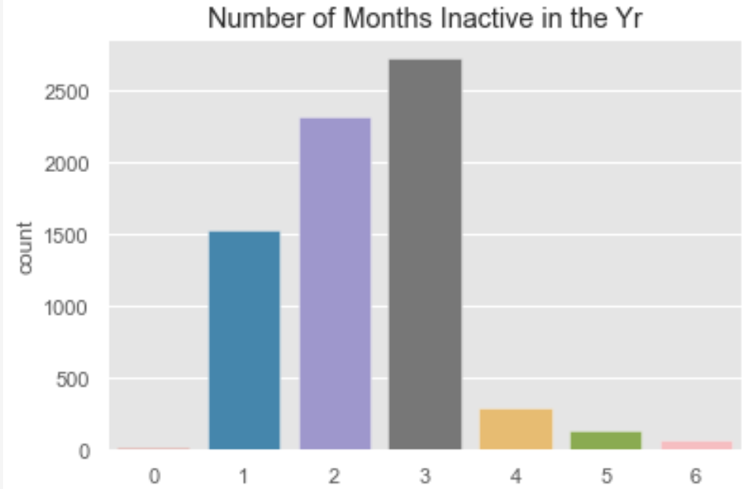
Majority of customers do not consistently use their card every month of the year
Related to previous
Almost no customer use their card every month of the year consistently (i.e. 0 inactive months)
Likely customers have other cards they utilize on a regular basis, perhaps only using our card for certain category purchases

Slide 9
Key Takeaway 1: Implement strategies to increase consistency in credit card usage
Key Takeaway 2: Market credit cards to older customers as they hold their credit cards for a longer period
Decrease in usage in Q4 of the year
Majority of customers have 1-3 months inactive
Months on book do not affect attrition rate
Older customers hold their cards longer

Slide 10
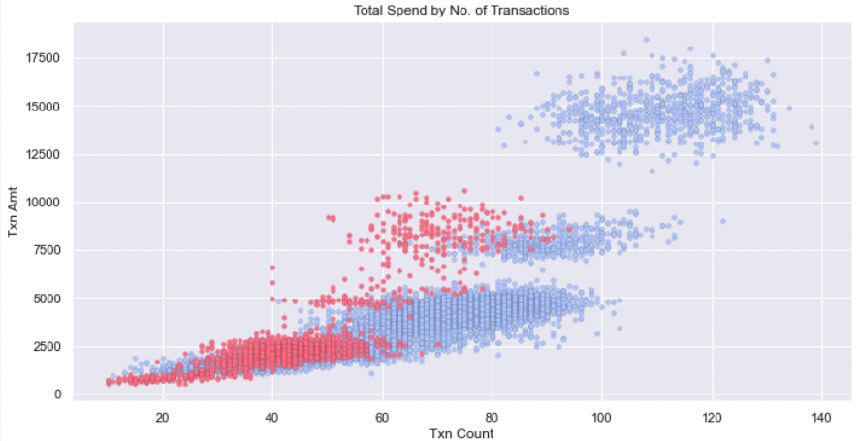
Customers who utilize their card a lot are unlikely to have attrition
High Spenders
Spend above ~$11k per year
Make more than 100 transactions
Middle Spenders
Low Spenders

Slide 11
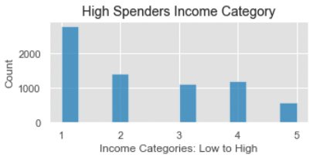
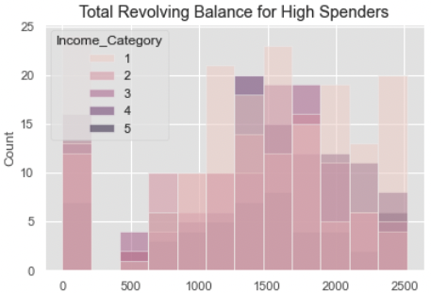
'High’ spending is not restricted by customer income category and contributes to revenue
‘High’ spenders (>11k) span all income categories – all customers can ‘afford to’ regardless of credit limit
They also tend to utilize revolving balance, likely bringing in more revenue for the bank

Slide 12
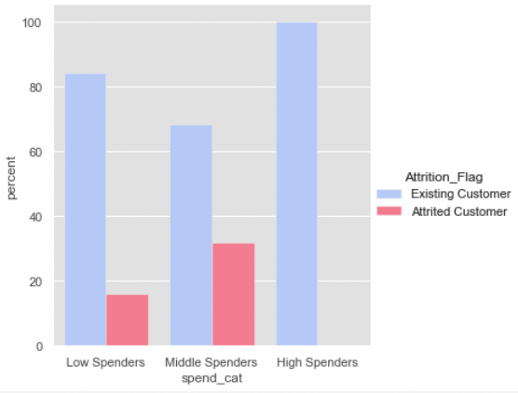
Middle spenders are more likely to attrite than low spenders
Attrition in ‘middle’ spenders are almost twice that of the low spenders

Slide 13
Key Takeaway 3: Encourage all customers to have ‘high’ spending pattern, focusing especially on ‘middle’ spenders
No attrition amongst high spenders
High spending is ‘possible’ for all income categories
High spending nets more revenue due to higher usage of revolving balance
Middle spenders are more likely to attrite, and closer to high spend range, making them an effective demographic to focus on

Slide 14
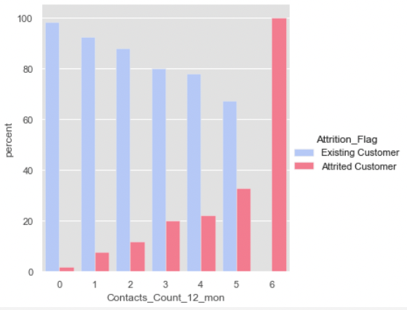
More contact points with the bank throughout the past 12 months result in greater percentage of attrition
Percentage of customers who attrite goes up with the number of contact counts
100% of customers attrite at 6 contact counts.

Slide 15
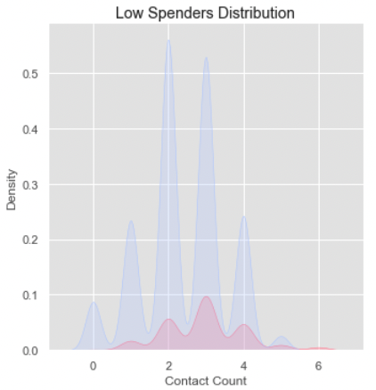
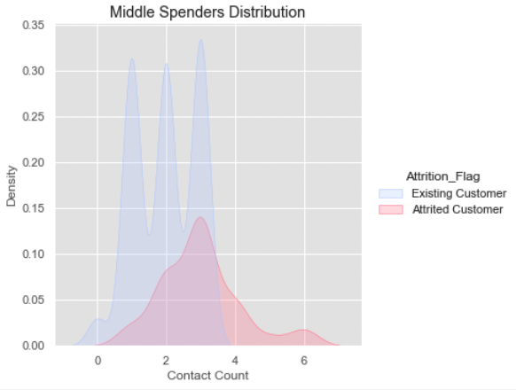
Middle spenders show greater sensitivity; all customers with 4 or more contact show attrition
100% attrition

Slide 16
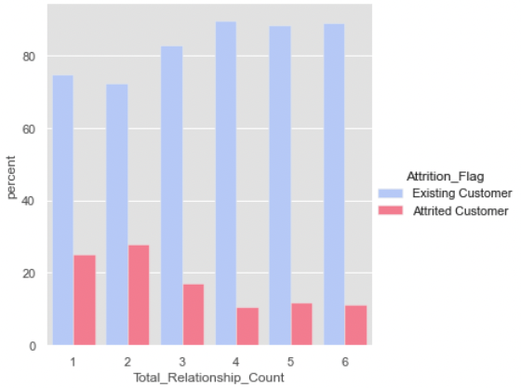
Customers who have less products with the bank are more likely to have attrition
Customers with less than 3 total products with the bank exhibit more than 20% attrition
Likely these customers are less ‘invested’ in the bank, making it easier to leave

Slide 17
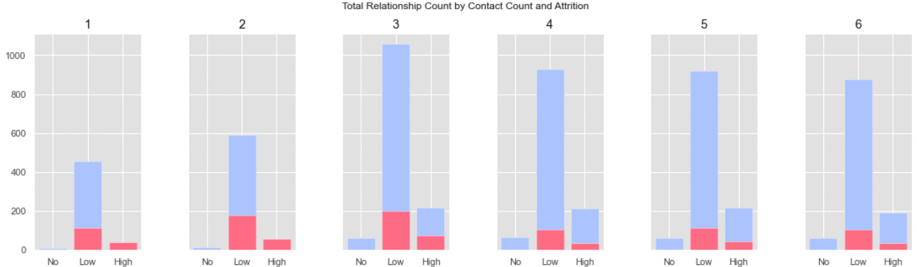
Customers with less than 3 products with the bank and high contact count all attrite

Slide 18
Key Takeaway 4: Focus on customer service and recovery, especially with middle spenders and customers with less than 3 products
More contact points generally indicate greater chance of attrition
More than 4 contact points for middle spenders and customers with 1-2 products a high indicator for attrition
Contact points could be due to dissatisfaction or problems in utilizing the credit card
Increase cross-sell efforts to customers with less than 3 products

Slide 19
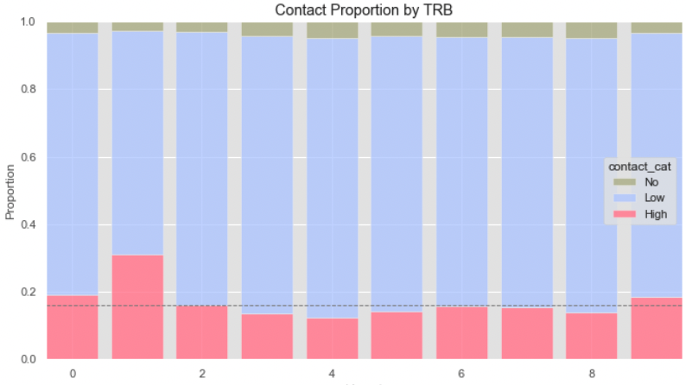
'High’ contact is likelier for customers with total revolving balance of 250-500
Low TRB showing high contact may indicate customers who inadvertently pay lower than what was due and may be calling to waive interest, etc
TRB: 250-500
Avg. proportion of ’High’ Contact

Slide 20
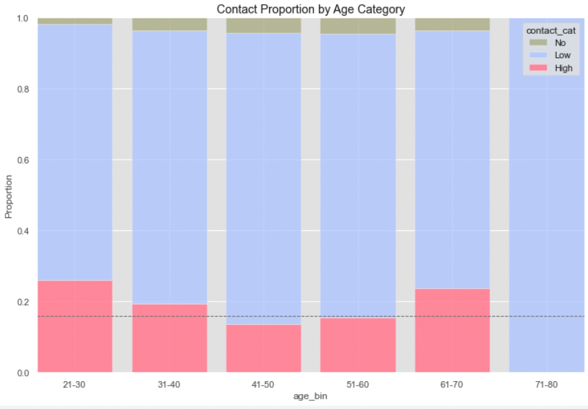
‘High’ contact is also more likely for young adults and retirees
Retirees may need more help with understanding banking products
Young adults may be savvier and want to use more banking features which require contacting the bank (e.g. temp credit increase, promotions, etc)

Slide 21
Key Takeaway 5: Lower contact count through improving product ease-of-use and self-service banking features
Potential reasons for contact:
Enquire on total revolving balance, perhaps on interest or waiver of interest
Require assistance in understanding features or usage of credit card
Assistance or approval with unique features of credit card
Contact could be reduced with more self-service banking options and easier to use products

Slide 22
Summary
Insights | Recommendation and Ideas
Majority of customers decrease their usage in Q4 compared to Q1 Majority of customers do not use their cards consistently throughout the year, having 1-3 months of inactivity | Have seasonal promotions or partnerships with purchase categories that are more likely in Q4 such as travel, gifts, etc Make the card better for daily use, with features for everyday type purchases (e.g. petrol, groceries)
Older customers tend to have longer months on book with their credit card Majority of customers in the 40-50 yr old range On-book length does not increase attrition rate | Market the credit card to mature customers Consider spending patterns by age-group to increase spending amount and consistency

Slide 23
Summary
Insights | Recommendation and Ideas
Middle spenders are most likely to have attrition, while high spenders show no attrition | Encourage middle spenders to cross the threshold to high spending via targeted promotions
High contact count through the year significantly increases attrition rate, especially for customers with low number of products and middle spenders | Improve customer service/recovery for at-risk population Cross-sell products to customers with less than 3 products
Contact count is higher for customers utilizing revolving balance but at a low rate (250-500) Higher contact is more likely for the younger and older populations | Investigate reason for increased contact Implement self-service banking for frequently requested services Improve ease-of-use

